Slide 1
Objects Introduction and Other Important Topics...

Slide 2
Recall Classes and Objects
Classes either…
Serve the role of software module (collections of related methods and their necessary variables)
Represent real-world things
As software module:
Generally only one instance created at a time (multiple instances for simultaneous work)
As real-world representation:
Each instance directly represents a single “thing”
Two cars of the same make/model, but different VINs, colors, etc.
POJO – Plain Ol’ Java Object

Slide 3

Example
Let’s say we were creating a program for an animal shelter – in this shelter we have a number of dogs. We want a program to model these dogs.
Each dog in our shelter has certain characteristics
Woof!
As well as certain behaviors like barking
name
weight
breed
age

Slide 4
Dog Class
Then we want to create a Dog class to model these characteristics and behaviors.
Our state or characteristics, name, weight, breed, and age, will be saved in variables and our behavior, barking, will be defined in a method.

Slide 5
Dog
NOTE: This class doesn’t actually run or do anything at all on its own.
It provides the code that would need to be used somewhere else in the program.
public class Dog {
String name;
double weight;
String breed;
int age;
public void bark(){
System.out.println(“Woof!!”);
}
}

Slide 6
Using the Dog class…
public class Dog {
String name;
double weight;
String breed;
int age;
public void bark(){
System.out.println(“Woof!!”);
}
}
Scruffy
Woof!
Daisy
public class TestDog {
public static void main(String[] args){
Dog daisy = new Dog();
daisy.name = “Daisy”;
daisy.bark();
Dog scruffy = new Dog();
scruffy.name = “Scruffy”;
}
}

Slide 7
Objects as Representations
A class is a blueprint for objects
Outline shared states and behaviors for instances
Values of those states may change
An object methods may change the object’s state
Dog class has a variable “isFed”, an eat() method may change that variable’s value to “true”
An object’s state is unique to itself. Each object operates its own behavior independently.
With exceptions.

Slide 8
Constructors
Constructors are used to create objects.
Instantiating the class
When a new object is created from a class, the class’ constructor is run.
Example myExample = new Example();
They have no return type and always are named with the same name as the class in which they are defined.
Every class must have at least one constructor.
If you don’t provide one, a default no-argument constructor is implicitly provided.
public MyClass() {} // it looks like this
If you do provide a constructor, you lose the default one!

Slide 9
Default Constructor
package one;
public class Dog {
private double size = 6.5;
public Dog(){}
public double getSize(){
return this.size;
}
public void setSize(double size){
this.size = size;
}
}
Here implicitly.
package two;
import one.Dog;
public class TestDog{
public static void main(String[] args){
Dog dog = new Dog();
dog.setSize(9.0);
System.out.println(dog.getSize());
}
}
This is how we would invoke that constructor (regardless of whether it was explicitly or implicitly defined). It reserves the memory needed to store all of the variables associated with our Dog object.

Slide 10
Constructor Overloading
A class can have multiple constructors, differentiated by their parameters
public Example() { }
public Example(int num) { }
public Example(int num, String name) { }
Calling a specific constructor is a matter of passing in the right types/numbers of parameters.
Example myEx = new Example(3);

Slide 11


this()…
When you call a constructor only one of the constructors in each class runs unless one of the constructors calls this(…)
this is a reference to the current class, so this() is an invocation of one of the current class’ constructors.
this() can be used in place of - it must be the first instruction of the constructor.
package one;
public class Dog {
private double size = 6.5;
public Dog(){this(12);}
public Dog(int size){
this.size = size;
}
}

Slide 12
Class Relationships
OOP seeks to, whenever possible, eliminate redundant/repetitive code and promote re-use
To this end, a class can…
“inherit” states and behaviors from another
“Is-A(n)” relationship (More on this in a few weeks)
create/contain an instance of another
“Has-A(n)” relationship, “Composition”
Classes inherit, not the objects themselves-
states are inherited, not their specific values.
(More on this in a few weeks)

Slide 13
HAS-A
public class Collar {
String color = “orange”;
}
public class Dog {
//instance variable- state of a Dog object
public double size = 6.5;
public Collar collar = new Collar();
}
public class TestDog{
public static void main(String[] args){
Dog dog = new Dog();
}
}

Slide 14

Background…
Recall how we typically call/invoke an instance method
First we declare/define it.
public class Dog{
public void bark(){
System.out.println(“woof!”);
}
}
public class TestDog{
public static void main(String[] args){
Dog daisy = new Dog();
daisy.bark();
}
}
Running these instructions
Then we call the instance method on our object.

Slide 15
Now this…
So what if we want the instructions in our method to affect the state of the object that the method is called on…
That’s why we have the this keyword- a reference to the current object.
So let’s see this in action.

Slide 16
This in action
Let’s create a Dog class with an instance variable size. Let’s also create a grow method…
public class Dog{
public double size = 5.5;
public void grow(){
this.size += 1;
}
}
public class TestDog{
public static void main(String[] args){
Dog daisy = new Dog();
daisy.grow();
}
}
Here we use the this keyword to indicate that we want to modify the size of the Dog object grow() is called on.
Running these instructions
Then we call the instance method on our object.

Slide 17
Clarifications
If you are sitting there going- but couldn’t we have just said:
You are correct.
So then why?
Using this makes it even more clear that you are referring to an instance variable.
Also, we could have created a local size variable- having two variables of the same name we need a way to differentiate between them.
public class Dog{
public double size = 5.5;
public void grow(){
size += 1;
}
}

Slide 18
This in action
Now the word size refers to the parameter, size.
public class Dog{
public double size = 5.5;
public void growToSize(double size){
this.size = size;
}
}
public class TestDog{
public static void main(String[] args){
Dog daisy = new Dog();
daisy.growToSize(7.7);
}
}
So we use the this keyword to refer to the actual size instance variable.

Slide 19
Modules
Java Platform Module System (JPMS)
Introduced with Java 9
Collection of associated packages, resources, and a module descriptor
Module descriptor specifies
Name of module
Dependencies
i.e. other modules that your module relies on
The packages available to other modules
And more…

Slide 20
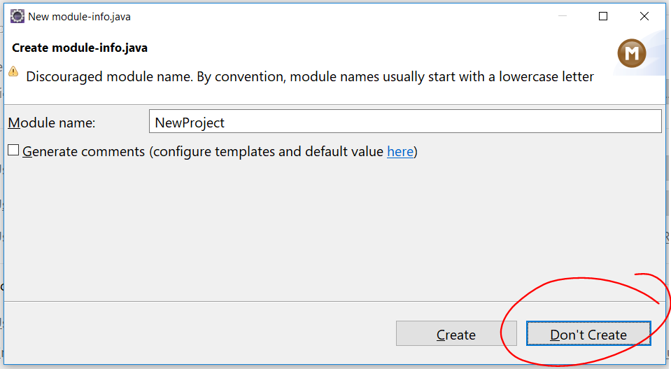
Module Descriptor
Created from module-info.java
module moduleName{
//module directives go in here
//technically all of these are optional
//you would specify things like
exports mypackage;
requires modulesNeededInModuleName;
}
For our purposes though you can simply select Don’t Create

Slide 21
CLASSPATH
Only one class can be compiled at a time
If one class that is being compiled references another class, the compiler will search for the relevant compiled .class file.
public class Test2 { Test1 test = new Test1(); }
The “Classpath” is a list of all the directories where the compiler is allowed to look for dependent classes.
Will search in the current folder by default
Can search in other folders by compiling with the “-classpath folder1:folder2: …” flag
CLASSPATH can also be set as an OS environment variable.
IDEs will manage projects – every file in a project will be included in the classpath for that project. External libraries can be added as well (sometimes called the Build Path)

